Slide 1

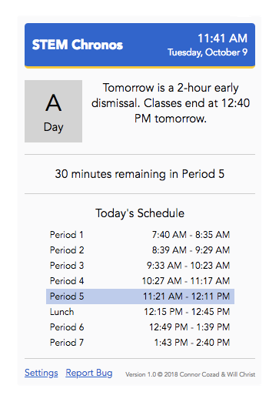
Introducing STEM Chronos
The easiest way to keep track of your class schedule at the Downingtown STEM Academy
Always just a click away in your Chrome browser’s toolbar!

Slide 2
Date and Time
The current date and time are always at your fingertips.
Letter Day
Message
We have twelve letter days. Check today’s letter day here.
Stay in the know about schedule changes with our custom message system.
Time Remaining
Manage your work knowing how much time is left in the period.
Schedule
View your schedule based on the letter day, your grade level, and more.
Current Period
The current period is always highlighted in light blue.

Slide 3
Date and Time
The current date and time are always at your fingertips.
Letter Day
Message
We have twelve letter days. Check today’s letter day here.
Stay in the know about schedule changes with our custom message system.
Time Remaining
Manage your work knowing how much time is left in the period.
Schedule
View your schedule based on the letter day, your grade level, and more.
Current Period
The current period is always highlighted in light blue.

Slide 4
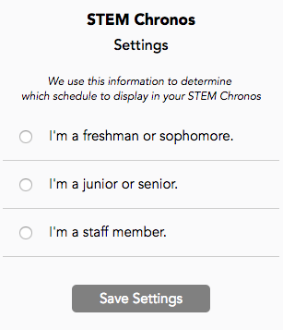
Will Chronos Work for Me?
Our advanced schedule display algorithm provides customized support for student and teacher schedules
Once you install, select your settings and Chronos handles the rest!
Chronos provides the most up-to-date schedule each time you open the extension!

Slide 5
Chronos Description
Between block days, two-hour early dismissals, two-hour delays, school-wide events, and more, schedules are always changing at the Downingtown STEM Academy.
STEM Chronos (Chronos, the Greek god of time) is a smart, simple, and easy way for students and staff members at the Downingtown STEM Academy to manage their schedules. STEM Chronos displays the current period, time, date, letter day, and schedule for the day with the click of a button right in your Chrome toolbar.
Our custom message system will always alert you to changes in your schedule.
Our innovative schedule display algorithm shows your schedule based on your grade level, as well as the current period and amount of time remaining in the period.
Simply install the extension and input your settings to begin.

